Slide 1
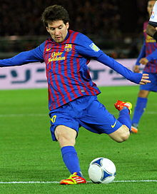
Statistics in professional soccer
A comparison of styles among the top professional soccer teams in the world

Slide 2
INTRODUCING THE DATA
Statistical revolution in other sports
  Why not in soccer?
Statistics kept during soccer games
Individual vs. Team Statistics
Goals for and goals against for winners of EPL, La Liga, MLS, and Serie A for past 6 seasons
  24 data points
    Nonparametric vs. Parametric methods

Slide 3




The data
Country Year Proportion GF Proportion GA GFPG GAPG
Spain 2006 66/38 40/38 1.73684 1.05263
Italy 2006 80/38 34/38 2.10526 0.89474
USA 2006 52/32 38/32 1.62500 1.18750
England 2006 83/38 27/38 2.18421 0.71053
Spain 2007 84/38 36/38 2.21053 0.94737
Italy 2007 69/38 26/38 1.81579 0.68421
USA 2007 56/30 34/30 1.86667 1.13333
England 2007 80/38 22/38 2.10526 0.57895
Spain 2008 105/38 35/38 2.76316 0.92105
Italy 2008 70/38 32/38 1.84211 0.84211
USA 2008 50/30 36/30 1.66667 1.20000
England 2008 68/38 24/38 1.78947 0.63158
Spain 2009 98/38 24/38 2.57895 0.63158
Italy 2009 75/38 34/38 1.97368 0.89474
USA 2009 41/30 31/30 1.36667 1.03333
England 2009 103/38 32/38 2.71053 0.84211
Spain 2010 95/38 21/38 2.50000 0.55263
Italy 2010 65/38 24/38 1.71053 0.63158
USA 2010 44/30 26/30 1.46667 0.86667
England 2010 78/38 37/38 2.05263 0.97368
Spain 2011 121/38 32/28 3.18421 1.14286
Italy 2011 68/38 20/38 1.78947 0.52632
USA 2011 48/34 28/34 1.41176 0.82353
England 2011 93/38 29/38 2.44737 0.76316

Slide 4
Explanation of Styles
Italy
  Catenaccio
Spain
  Tiki-Taka
USA
  Not developed their own style
England
  International mix of styles

Slide 5
Testing for general differences between leagues (Kruskal-Wallis)
Model
  Y_{ij}=Ɵ+τ_{j}+ϵ_{ij}, i=1..6, j=1..4
H_{o}: τ₁=τ₂=τ₃=τ₄
H_{a}: Not all τ_{j}’s are equal.
H = 14.38 DF = 3 P = 0.002
Conclusion

Slide 6
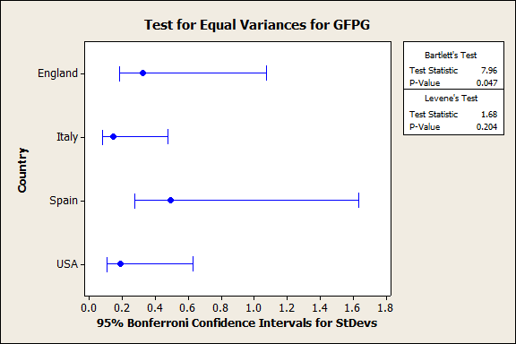
Assumptions

Slide 7
Parametric Equivalent: One-Way Anova
Model
  Y_{ij}=m+a_{i}+e_{ij} i=1..6,j=1..4
H₀: µ₁= µ₂= µ₃= µ₄
H_{a}: Not all µ are equal.
P-value 0.000
  F=9.75, df=3,20

Slide 8
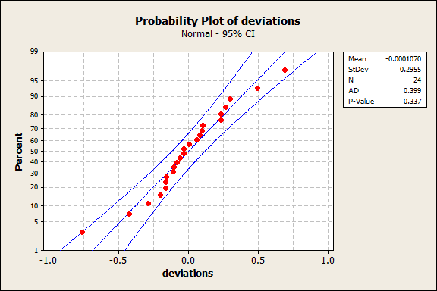
Testing for Normality

Slide 9
Another Way of Testing Variances
Descriptive Statistics: GFPG
Variable Country StDev
GFPG England 0.322
Italy 0.1426
Spain 0.492
USA 0.1884

Slide 10
Jonckheere-Terpstra Test For Ordered Alternatives
H_{o}: τ₁=τ₂=τ₃=τ₄
H_{a}: τ₄≤ τ₃≤ τ₂≤ τ₁
  Why did I choose this alternative?
J = 189, p-value = 1.549e-05
There is significant evidence of differences in goals for per game across countries
Which countries differ?

Slide 11
Multiple Comparisons
Decide τ_{u}≠τ_{v} if abs(W*_{uv})≥3.633, which is based on q_{α}, a large sample approximation
For Spain vs. USA, I got the following answer: (56-39)/4.415=3.90
England vs. USA: (56-39)/4.415=3.90
These were the only two significant differences

Slide 12
Tukey’s Method
Grouping Information Using Tukey Method
Country N Mean Grouping
Spain 6 2.4956 A
England 6 2.2149 A B
Italy 6 1.8728 B C
USA 6 1.5672 C

Slide 13
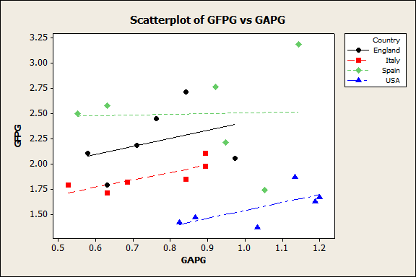
Comparing goals for and Goals Against: How do the Top Teams Win?

Slide 14
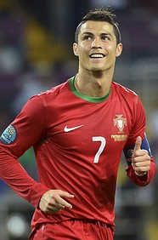
Nonparametric Correlation Techniques
Kendall's rank correlation tau
data: Goalsf and Goalsa
z = -0.5221, p-value = 0.6016
Sample estimates:
tau
-0.07706539

Slide 15
Accounting for Recent Trends (General Linear Model)
Model
  Y_{i}=β₀+ β₁X_{i1}+ β₂X_{i2}+E_{i}
Estimate Std. Error t value Pr(>|t|)
(Intercept) -78.53435 72.16573 -1.088 0.289
Countries -0.31272 0.05488 -5.698 1.18e-05 ***
Year 0.04050 0.03593 1.127 0.272
No predictive linear relationship between Year and GFPG

Slide 16
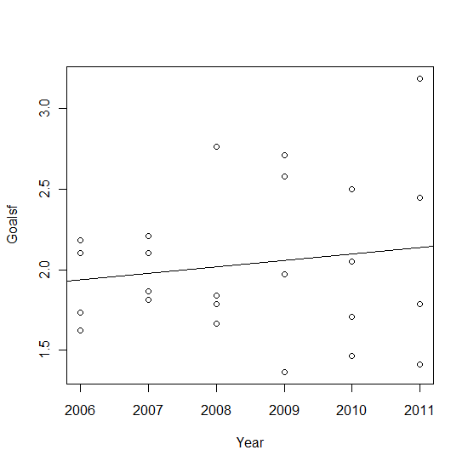
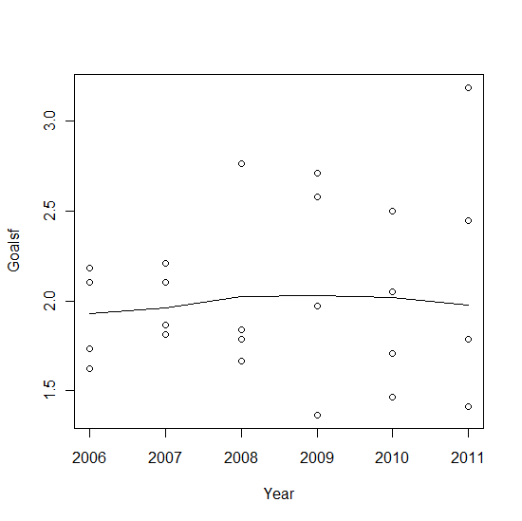
LSRL and LOWESS Models
Pearson R-sq= .7%

